Slide 1
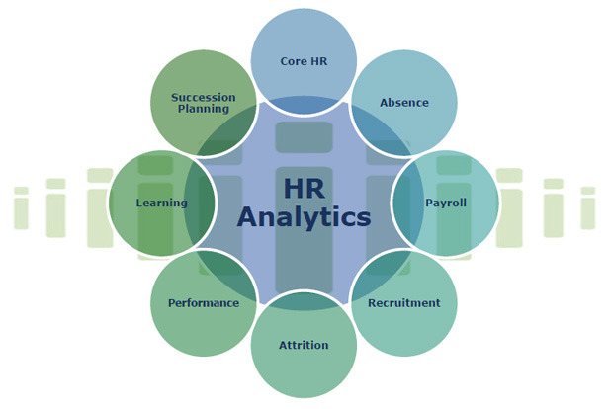

Slide 2
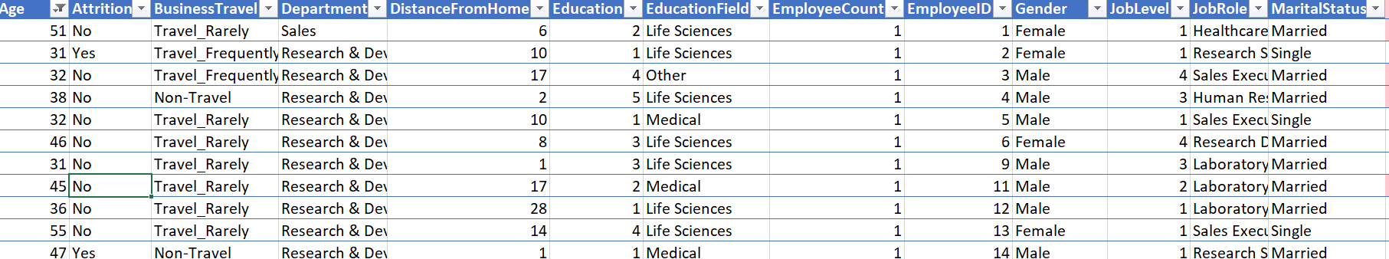
1. Using Excel, how would you filter the dataset to only show employees aged 30 and above.
click on sort & filter. then click on the Age Column dropdown Arrow. select on Number Filter and choose Greater than or equal to and enter 30 in diaglogbox and click on ok.

Slide 3
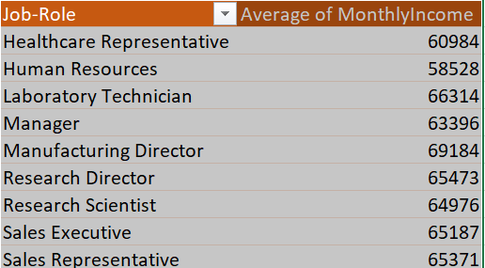
2. Create a pivot table to summarize the average Monthly Income by Job Role.?

Slide 4
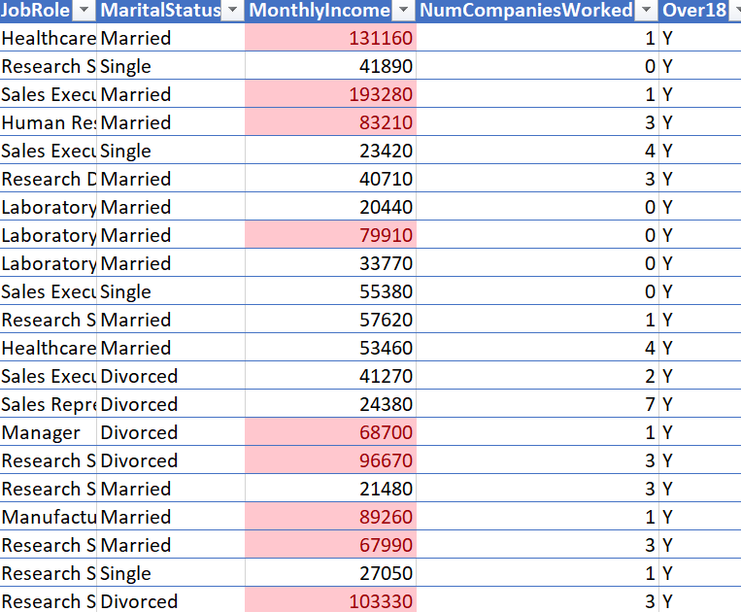
3. Apply conditional formatting to highlight employees with Monthly Income above the company's average income.

Slide 5
4. Create a bar chart in Excel to visualize the distribution of employee ages.

Slide 6
5. Identify and clean any missing or inconsistent data in the "Department" column..
By Checking Department Column the column data is Consistent ,clean and it doesn’t have any missing value.

Slide 7
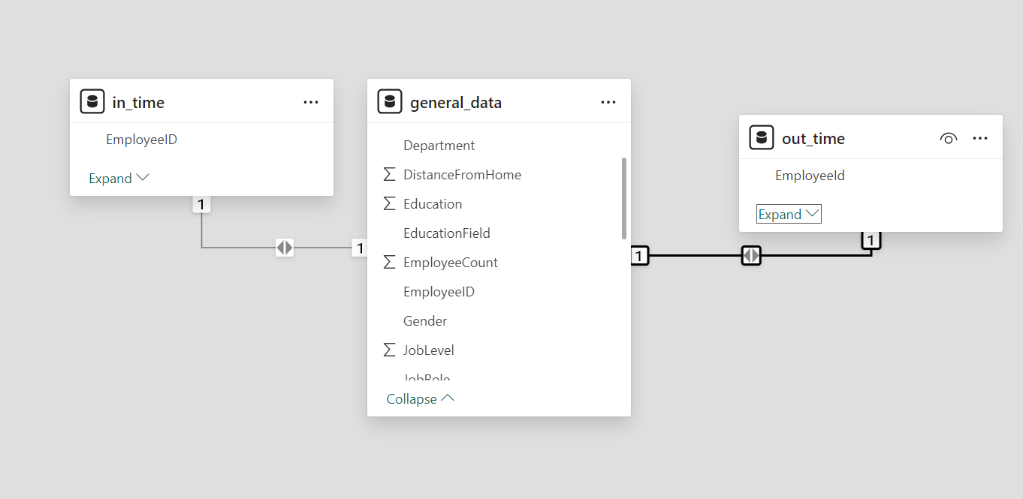
6. In Power BI, establish a relationship between the "EmployeeID" in the employee data and the "EmployeeID" in the time tracking data..

Slide 8
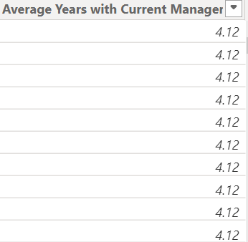
7. Using DAX, create a calculated column that calculates the average years an employee has spent with their current manager.

Slide 9
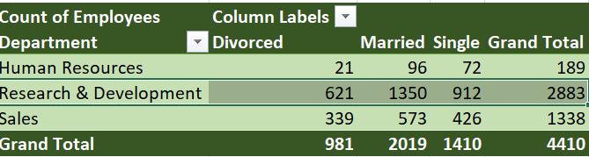
8. Using Excel, create a pivot table that displays the count of employees in each Marital Status category, segmented by Department.

Slide 10
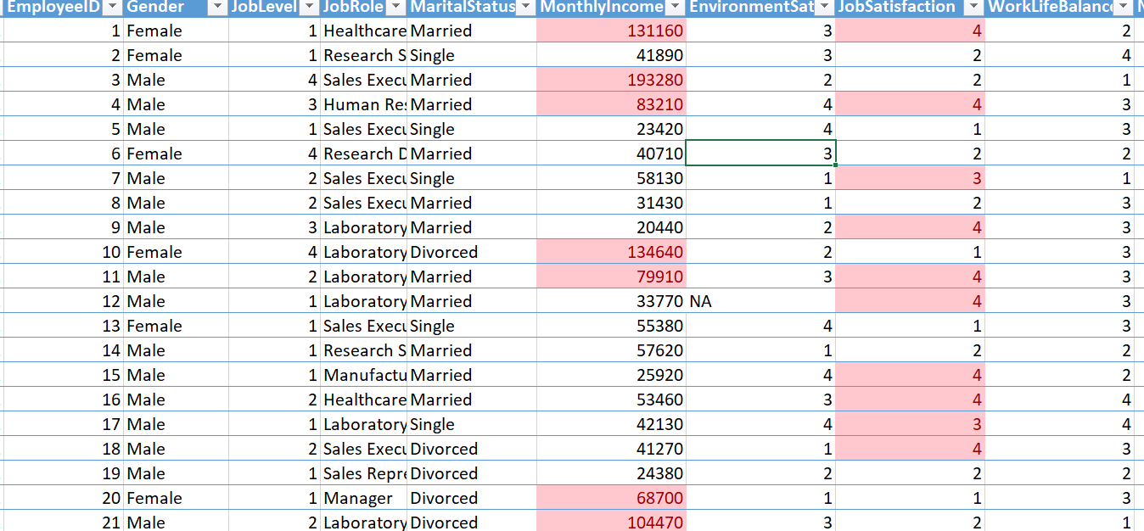
9. Apply conditional formatting to highlight employees with both above-average Monthly Income and above-average Job Satisfaction.

Slide 11
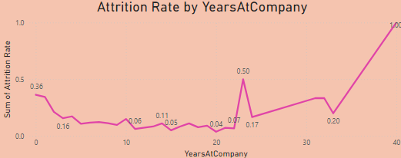
10. In Power BI, create a line chart that visualizes the trend of Employee Attrition over the years. .

Slide 12
11. Describe how you would create a star schema for this dataset, explaining the benefits of doing so.
A Star Schema is a Relational Database Schema that Consist of a Single Fact Table and one or more Fact Tables.
The Fact Table Consist of the quantitative data such as "Employee ID" and "Income".
The Dimension table contain the Categorical data such as "Location" and "Department“
With a star schema, complex queries can be written more easily because it clearly separates facts (metrics) from dimensions (context).

Slide 13
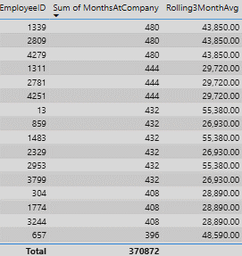
12. Using DAX, calculate the rolling 3-month average of Monthly Income for each employee.

Slide 14
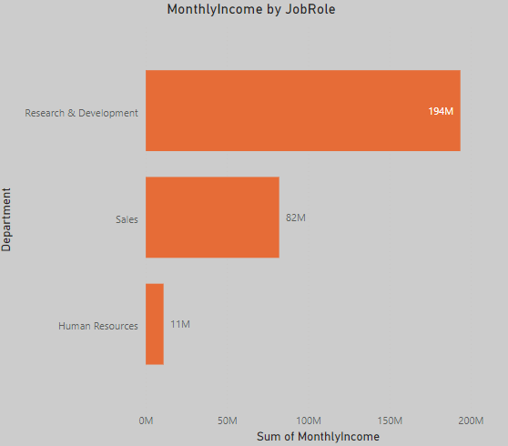
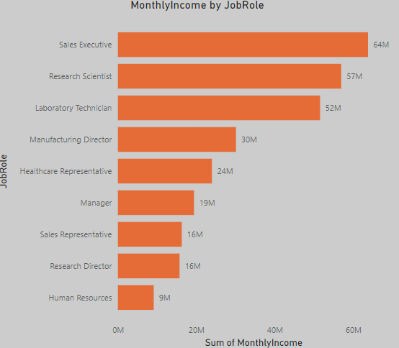
13. Create a hierarchy in Power BI that allows users to drill down from Department to Job Role to further narrow their analysis.

Slide 15

14. How can you set up parameterized queries in Power BI to allow users to filter data based 1 of 2 on the Distance from Home column.

Slide 16
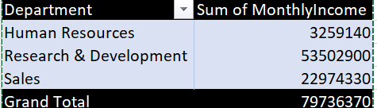
15. In Excel, calculate the total Monthly Income for each Department, considering only the employees with a Job Level greater than or equal to 3.

Slide 17
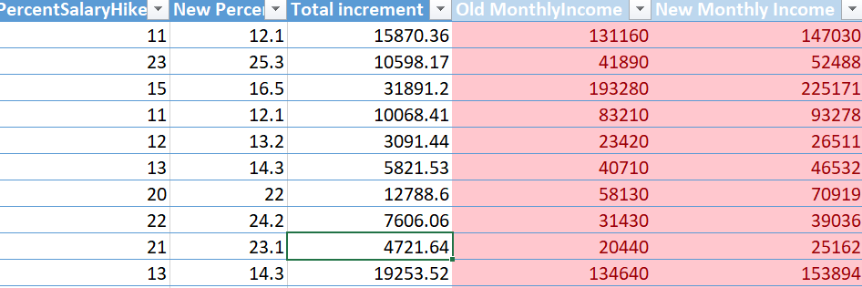
16. Explain how to perform a What-If analysis in Excel to understand the impact of a 10% increase in Percent Salary Hike on Monthly Income.

Slide 18
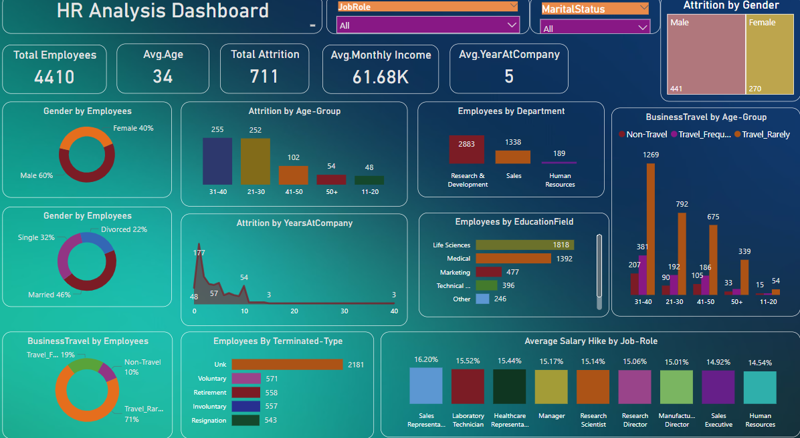

Slide 19


